Slide 1


Authorized channel Partner of
ELECTRONICS
Unearthing solutions in Electro-Mechanical
Low & Medium Voltage Control & Automation Instrumentation
ONE ROOF, MANY SOLUTIONS
Developed & Managed by INDITRON ELECTRONICS

Slide 2

C
Company Profile
We offer a broad spectrum of Electro Mechanical Solutions which have all the core technological resources for the manufacturing and process industries.
Making use of all the available resources and exploiting the advancement in technologies from different industries, we customize the solutions as per your need. Ours is a one-of-a-kind industry where innovation happens from an objective point of view.
We provide process-centric solutions which are developed for a specific process alone.
Our company provided facilities are:
Planning, Designing, Detailing, Procurement, Manufacturing, Supply, Installation, Testing and commissioning of all kinds of electrical and instrumentation equipments.
Developed & Managed by INDITRON ELECTRONICS

Slide 3


CHITRANSH ELECTRICALS
WE BEGINES WHERE
ENGINEERS END
Developed & Managed by INDITRON ELECTRONICS

Slide 4
C
Company Profile
CHITRANSH ELECTRICALS was established in the year 1999 in Dewas (M.P.). Over the years Chitransh Electricals has earned a reputation of providing quality services to meet requirements of major players from almost every industrial sectors – Engineering, Food & beverages, Automobiles, Rubber, Plastic, Thermal powers, Petrochemicals, Steel etc in India. This has been achieved by taking special care in bringing resources with appropriate skills for required projects. Chitransh Electricals actively involved in Electricals, instrumentation and Mechnical work and erection (Mechanical, Electrical and Instrumentation work), testing, commissioning of pretreatment plants, demineralization plants, raw water treatment plants, water recirculation systems, ETP, RO (Reverse Osmosis) plants etc. and Operation & Maintenance of water & waste management systems.
Today Chitransh Electricals has reached the critical mass, from where it is ideally suited to provide boundless service and care,
Developed & Managed by INDITRON ELECTRONICS

Slide 5
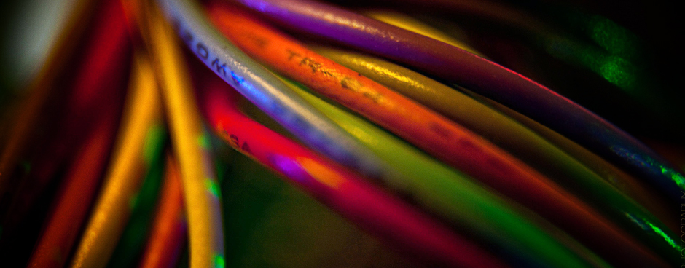
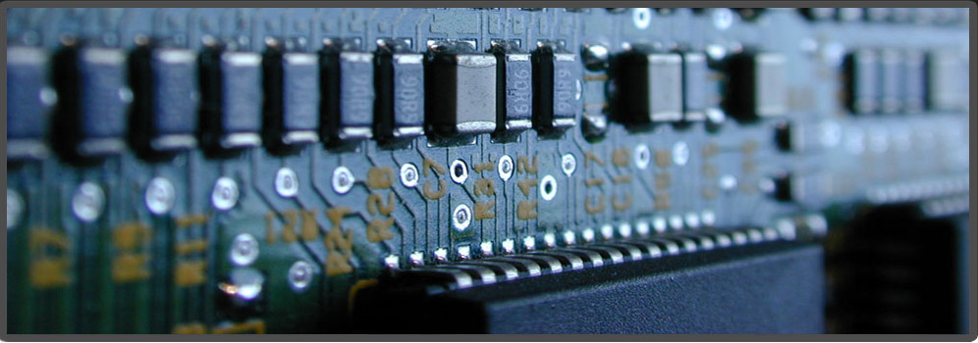
LIST OF OUR MANUFACTURING & SERVICE PRODUCTS
Electrical Panel Board.
Control & Automation.
Water Treatment Plant manufacturer.
Electrical, Mechanical & Instrumentation installation work
Operation & maintenance of plant
Electrical & Instrumentation design & consultancy
Developed & Managed by INDITRON ELECTRONICS

Slide 6


PANEL BOARDS
The leading manufacturer and supplier of a wide array of control panel boards; we base our products on the latest technology. Entire product range offered by us is in varied specifications to suit the requirements of the clients. Features like low maintenance, high quality, customization and easy installation, coupled with installation service at the client’s end makes us end to end solution provider.
Automatic Power Factors Correction Panel (APFC).
Control Panel Board (CP).
Extension Panel .
Fir e System Panel.
Hydro-pneumatic System Panel.
Industrial Junction Box.
Industrial Plant maintenance and service.
Motor Control Centres Panel (MCC).
Power Control Centre Panel (PCC).
Power Distribution Board Panel (PDB).
Programmable Logic Controller Panel (PLC).
Solenoid Mould Box (SM BOX).
Standardised Controllers.
Standardised Panels.
Starter Panels.
Developed & Managed by INDITRON ELECTRONICS

Slide 7
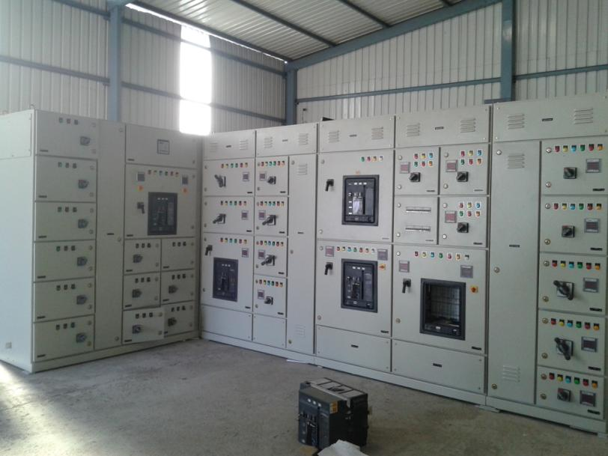
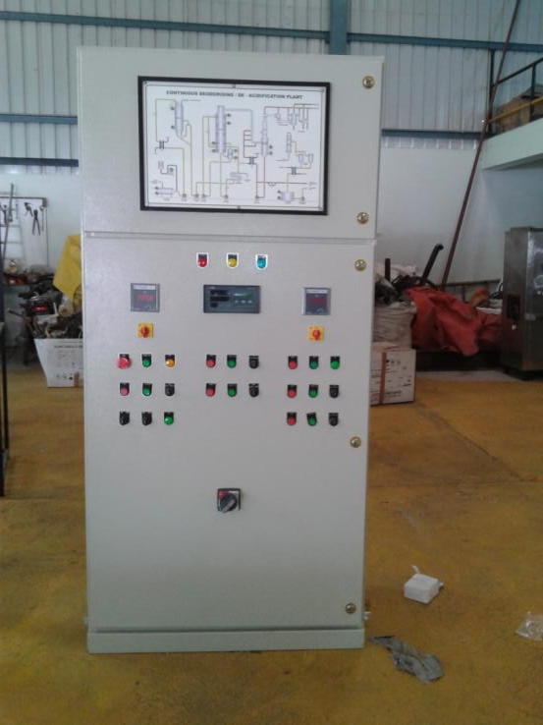
PHOTOGRAPH OF EXUCUTED PROJECT
APFC CUM PCC PANEL AT IIM INDORE
REMOTE MIMIC PANEL
Developed & Managed by INDITRON ELECTRONICS

Slide 8
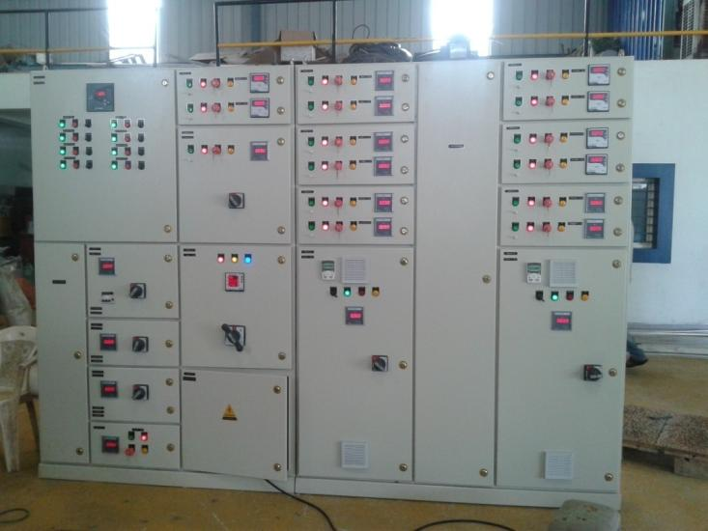
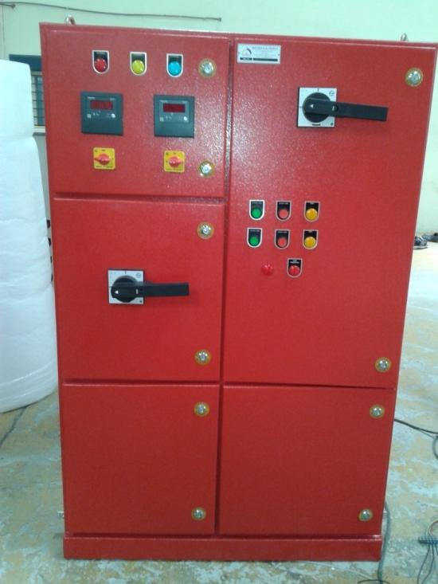
PHOTOGRAPH OF EXUCUTED PROJECT
MCC CUM APFC PANEL AT STABICON SDN BHD
FIRE FIGHTING PANEL
Developed & Managed by INDITRON ELECTRONICS

Slide 9
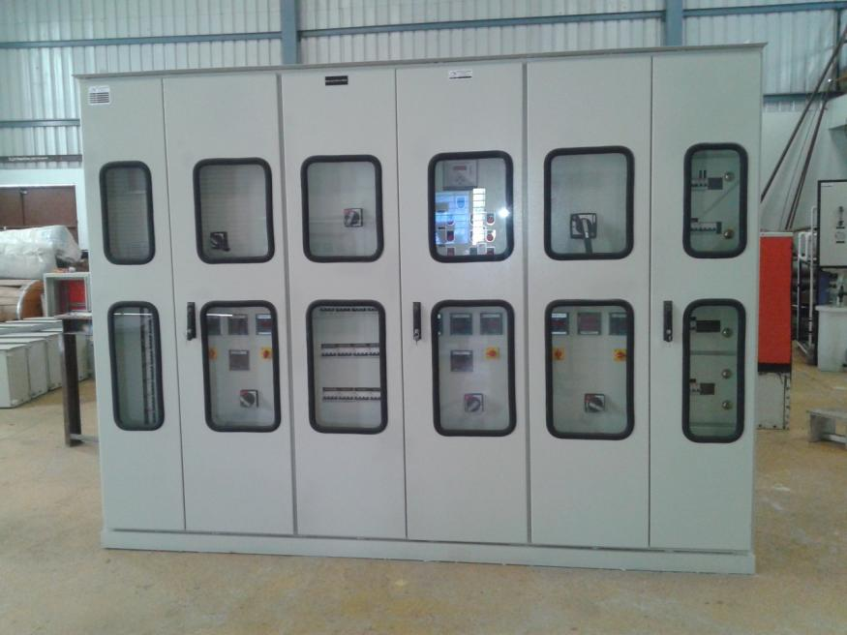
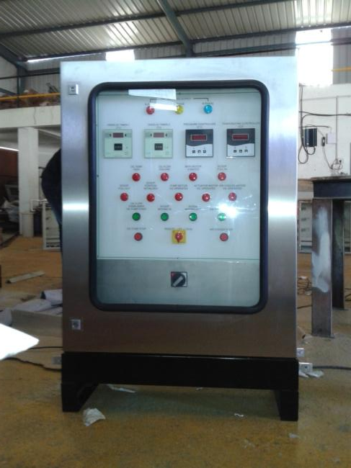
PHOTOGRAPH OF EXUCUTED PROJECT
ATEX ENCLOSURE FOR FLUIDOMAT
OUTDOOR TYPE DISTRIBUTION PANEL
Developed & Managed by INDITRON ELECTRONICS

Slide 10
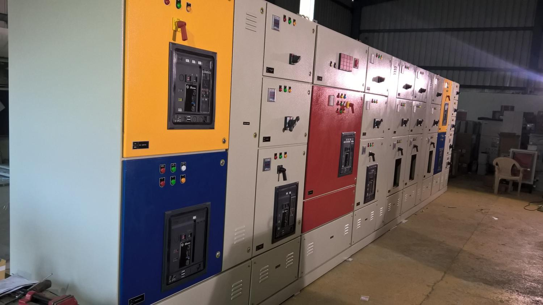
PHOTOGRAPH OF EXUCUTED PROJECT
PCC PANEL AT NAVIN FLUORINE INTERNATIONAL
INCOMMER – 6300A FP ACB
DG – 1600A FP ACB X 2 NOS
B/C – 1600A FP ACB X 2 NOS
O/G – 1600A FP ACB X 5 NOS
Developed & Managed by INDITRON ELECTRONICS

Slide 11


CONTROL & AUTOMATION
We undertake projects of engineering outstanding services for entire range of control and Automation System deliverables. Our end to end services include proposal support, bid evaluation, consultation services, on site professional services, as built documentation and commissioning support.
Our solutions include complete automation and control system, electrical and control room layouts, power distribution equipment, variable AC and DC drive systems, control system software development for technological controls, automatic sequences, HMI, software modules followed by complete system integration etc. In all we become one vendor with many solutions for control and automation.
Developed & Managed by INDITRON ELECTRONICS

Slide 12
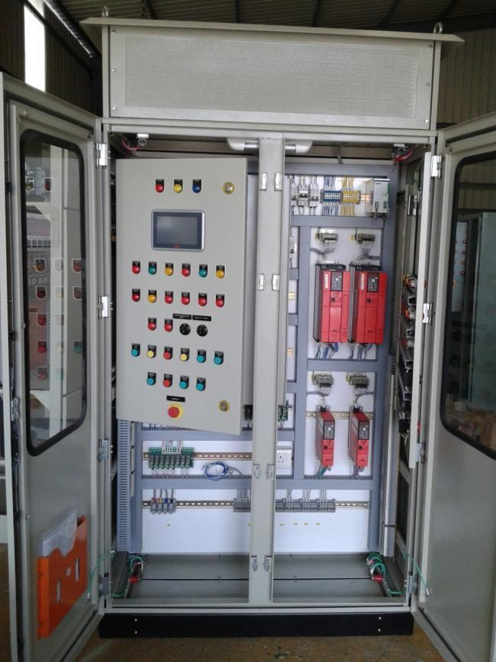
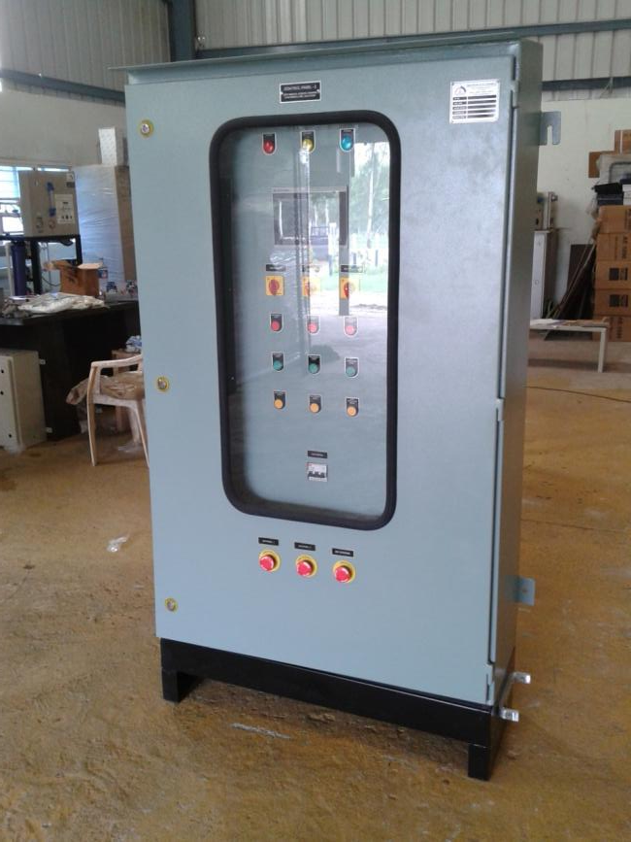
TYPICAL PLC PANEL FOR JASH ENGINEERING
Developed & Managed by INDITRON ELECTRONICS

Slide 13
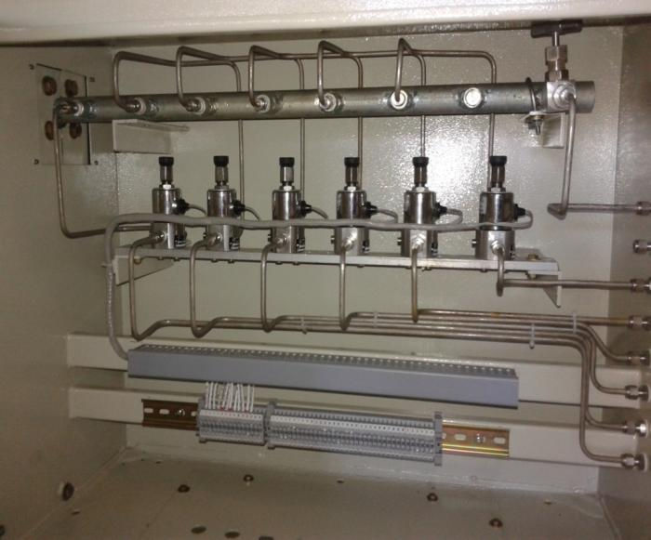
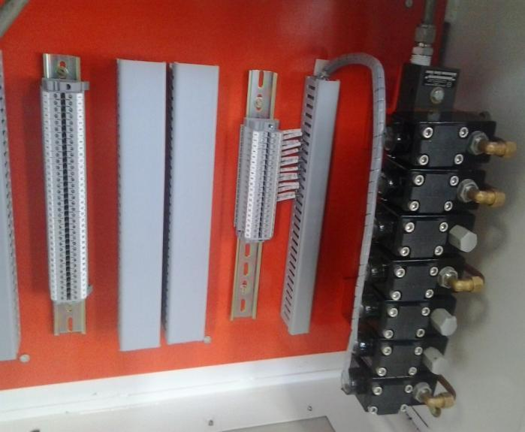
PHOTOGRAPH OF EXUCUTED PROJECT
TYPICAL PICTURE FOR SM BOX
Developed & Managed by INDITRON ELECTRONICS

Slide 14
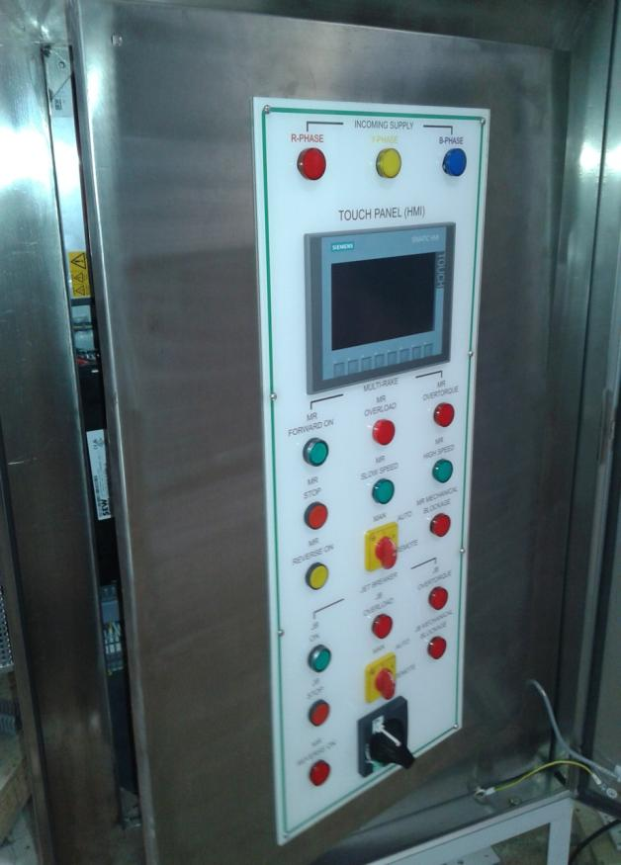
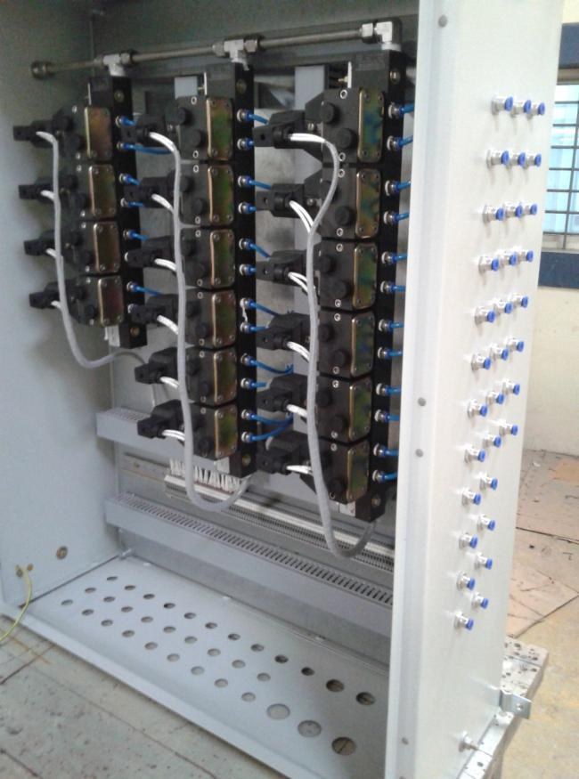
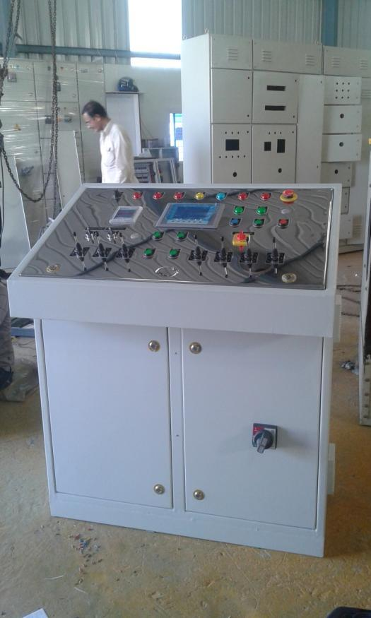
Developed & Managed by INDITRON ELECTRONICS

Slide 15
LIST OF MAJOR PROJECT EXCUTED IN PANEL BOARD, ELECTRICAL & AUTOMATION
SR NO. | PROJECT NAME | SCOPE OF WORK | FY YEAR | PROJECT COST
1. | INDIAN INSTITUTE OF MANAGEMENT INDORE | SUPPLY, INSTALLATION, TESTING AND COMMISSIONING OF LT PANEL CUM APFC PANEL | 2014-2015 | 47 LACK
2. | NAVIN FLUORINE INTERNATIONAL LIMITED | 3500 kVA Switchyard Work | 2015-2016 | 79 LACK
3. | FLUIDOMAT LIMITED | DISTRIBUTION PANELS, CONTROL PANELS & APFC PANELS | 2015-2016 | 58 LACK
4. | TATA INTERNATIONAL LIMITED, DEWAS | ELECTRICAL, INSTRUMENTS VALVE, PACKAGE FOR ETP | 2015-2016 | 58 LACK
5. | INDIAN INSTITUE OF MANAGEMENT INDORE | Manufacturing, Supply Installation, testing & commissioning of Electrical control panels and LT cabling, lighting fixtures etc. | 2015-2016 | 23 LACK
6. | STABICON ADDITIVES SDN BHD | MCC Panel CUM APFC PANEL | 2015-2016 | USD 10618
7. | STI SANOH INDIA LIMITED | POWER DISTRIBUTION PANEL FOR 1000 kVA TRANSFORMER | 2015-2016 | 12.25 LACK
8. | DEWAS METAL SETCTION LIMITED –TAMIL NADU | ELCTRICAL PANEL ( DISTRIBUTION, LT, FEEDER PILLER, APFC) | 2015-2016 | 13.63 LACK
9. | DEWAS METAL SETCTION LIMITED – DEWAS | ELCTRICAL PANEL ( DISTRIBUTION,CHANGE OVER) | 2014- 2015 | 12.97 LACK
10. | HD WIRES PVT LTD. | VFD PANEL | 2015-2016 | 7.50 LACK
11. | ROCA BATHROOM PRODUCTS PRIVATE LIMITED | BALL MILL PANEL | 2015-2016 | 6.50 LACK
Developed & Managed by INDITRON ELECTRONICS

Slide 16
SR NO. | PROJECT NAME | SCOPE OF WORK | FY YEAR | PROJECT COST
11. | ASTERISK CHEMICALS PVT. LTD. | FEEDER PILLER PANEL & MCC PANEL | 2015-2016 | 9 LACK
12. | HD WIRES PVT LTD. | AMF CUM APFC PANEL | 2014-2015 | 35 LACK
13. | RANBAXY LABORATORIES LIMITED | ELECTRICAL PANEL | 2014-2015 | 1.5 LACK
14. | ROCA BATHROOM PRODUCTS PRIVATE LIMITED | TIMER PANEL | 2014-2015 | 4 LACK
15. | THERMAX LIMITED, PUNE | SM BOX FOR NMDC 3.0 MTPY INTEGRATED STEEL PLANT NAGARNAR, CHHATTISGARH | 2015-2016 | 13.88 LACK
16. | THERMAX LIMITED, PUNE | SM BOX FOR BHERAMARA COMBINED CYCLE POWER PLANT (360 MW) DEVELOPMENT PROJECT | 2015-2016 | 51 LACK
17. | JASH ENGINEERING LIMITED UNIT II | CONTROL PANEL FOR THEIR MULRIRAKE SCREEN OPERATED BY PLC CONTROLLER FOR BANGALORE WATER SUPPLY & SEWAREGE BOARD | 2015-2016 | 36 LACK
18. | RUCHI LIFESCAPES , BHOPAL | OUTDOOR TYPE FEEDER PILLER, OUTDOOR TYPE AUTOMATIC SWITCHING CUBICLE STREET LIGHT PANEL & DG PANEL | 2016-2017 | 62 LACK
19. | THINQ PHARMA CR0 LIMITED | SUPPLY & ERECTION OF ELECTRICAL PANELS./ HT SEOTCHGEAR/ LT SWITCHGEARS | 2017-2018 | 3.4 CORE
20. | THYSSENKRUPP INDUSTRIES INDIA PVT. LTD. | ELECTRICAL & INSTRUMENTATION ERECTION & COMMISSIONINNG OF SMCP | 2014-2015 | 52 LAC
21. | NAVIN FLUORINE INTERNATIONAL LIMITED | ELECTRICTRICATION WORK FOR cGMP-3 PLANT | 2019-TILL DATED | 4.7 CORE
Developed & Managed by INDITRON ELECTRONICS

Slide 17


WATER TREATMENT PLANT EQUIPMENTS
We are counted amongst the one of the prominent manufacturers and suppliers of a wide range of Water Treatment Plants. Innovative engineering concepts along with a diligent team and latest technology have helped us carve a niche for ourselves in the industry. We have gained immense appreciation among our clients, owing to the features such as high quality, low maintenance, easy installation and durability offered by our entire range.
Effluent Treatment Plants.
Sewage Treatment Plants.
Filtration System.
Membrane separation Plants.
Remote monitored RO systems.
Pre-treatment Plants.
Operation & Maintenance of utility Plants.
Developed & Managed by INDITRON ELECTRONICS

Slide 18
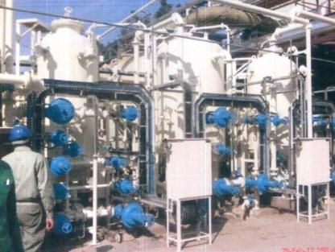
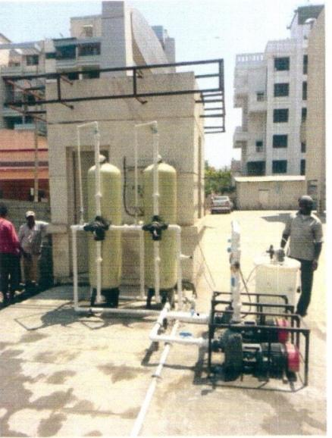
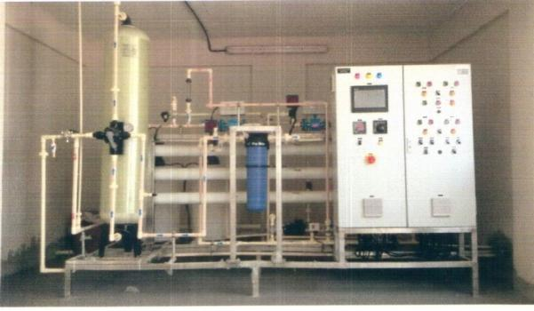
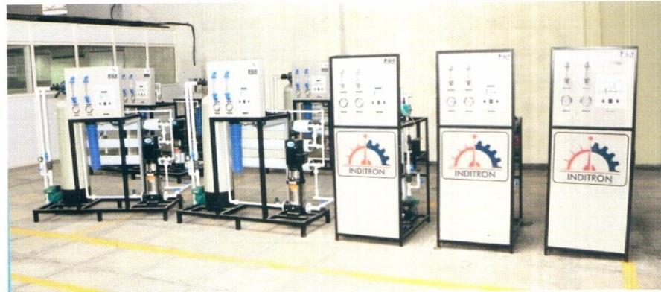
PHOTOGRAPH OF EXUCUTED PROJECT
SINGLE STREAM 50 m3/ hr DM PLANT
900 LPH RO PLANT FOR INBIOPRO BANGALORE
20 KLD ETP KITCHEN WASTE TREATMENT
500 LPH & 200 LPH RO PLANTS
Developed & Managed by INDITRON ELECTRONICS

Slide 19

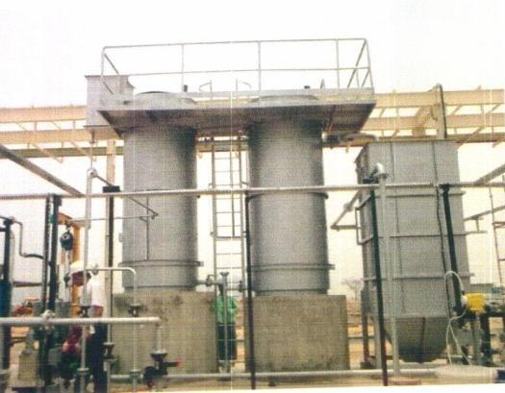
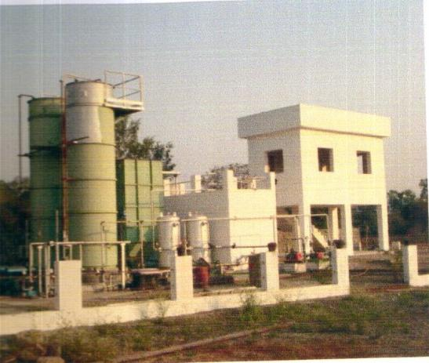
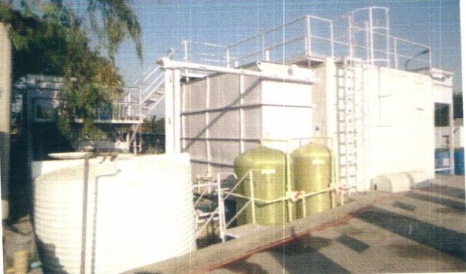
PHOTOGRAPH OF EXUCUTED PROJECT
40 KLD PRE-FABRICATED STP
150 KLD PRE FABRICATED STP KALKI SUPREME CONSTRUCTION
20 KLD ETP KITCHEN WASTE TREATMENT
150 KLD PRE FABRICATED STP EXTENDED AERATION AMTEK AUTO
Developed & Managed by INDITRON ELECTRONICS

Slide 20
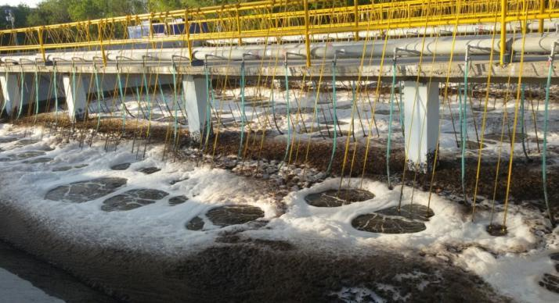
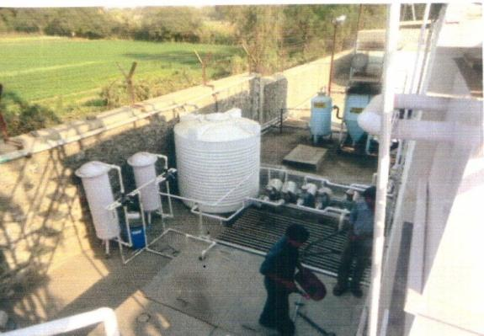
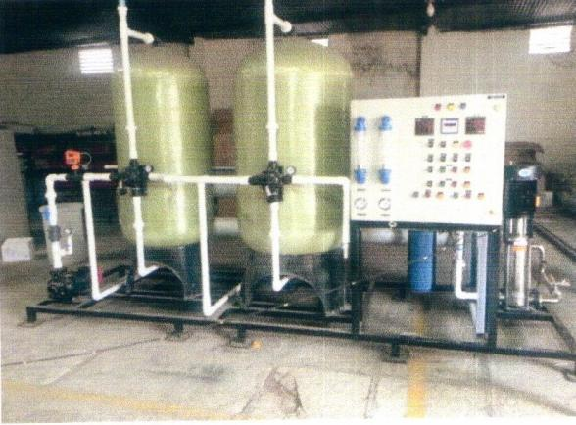
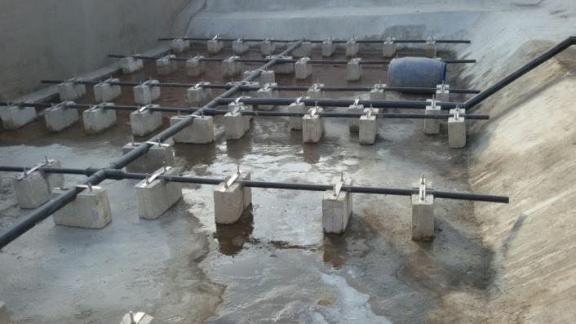
PHOTOGRAPH OF EXUCUTED PROJECT
300 KLD STP EXTENDED AERATION ENDURANCE
ETP at TATA INTERNATIONAL
5 m3/hr RO PLANT TSPDL
Developed & Managed by INDITRON ELECTRONICS

Slide 21
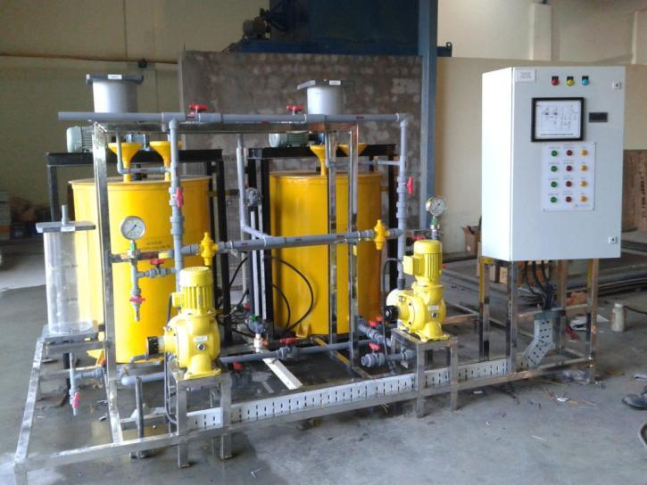
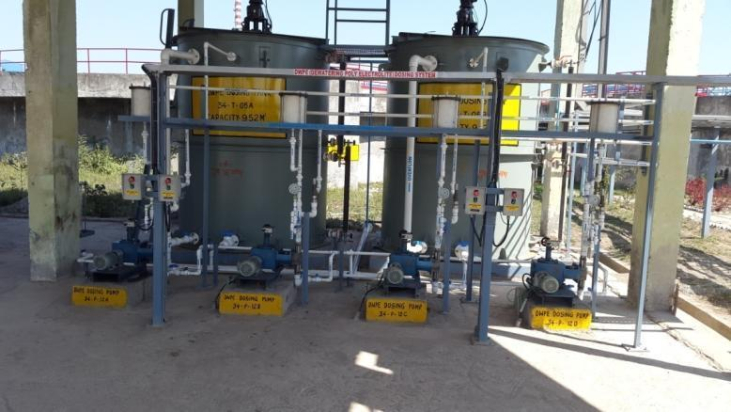
Developed & Managed by INDITRON ELECTRONICS

Slide 22
LIST OF MAJOR PROJECT EXCUTED in water treatment Project
SR NO. | PROJECT NAME | TYPE OF PLANT | SCOPE OF WORK | FY YEAR | PROJECT COST
1. | GVMC – 2 & 4 MLD | 2 MLD & 4 MLD SEWAGE TREATMENT PLANT | DESIGN, ENGINEERING, SUPPLY TESTING & COMMISSIONING | 2009-2010 | 41.5 LACK
2. | STERLING SEZ | 6 MLD SEWAGE TREATMENT PLANT | DESIGN, ENGINEERING, SUPPLY TESTING & COMMISSIONING | 2010-2011 | 85 LACK
3. | IMFA | 2 STREAM PT-DM-CWT PLANT | DESIGN, ENGINEERING, SUPPLY TESTING & COMMISSIONING | 2010-2011 | 63.5 LACK
4. | PHED Sikkim, GANGTOK | 3.9 MLD & 4.69 MLD SEWAGE TRATMENT PLANT | DESIGN, ENGINEERING, SUPPLY TESTING & COMMISSIONING | 2011-2012 | 39.8 LACK
5. | HINDALCO HIRAKU | RAW WATER PRE-TREATMENT PLANT | DESIGN, ENGINEERING, SUPPLY TESTING & COMMISSIONING | 2011-2012 | 26 LACK
6. | MARUTI SUZUKI INDIA LTD. | SINGLE STREAM DM PLANT | DESIGN, ENGINEERING, SUPPLY TESTING & COMMISSIONING | 2011-2012 | 36.75 LACK
7. | GARWARE INDUSTRIES AURANGABAD | 50 KLD STP | DESIGN, ENGINEERING, SUPPLY TESTING & COMMISSIONING | 2012-2013 | 9 LACK
8. | FEMACE AUTO LTD. PUNE | 100 KLD STP | DESIGN, ENGINEERING, SUPPLY TESTING & COMMISSIONING | 2012-2013 | 12.5 LACK
9. | CHETTINAD CEMENT | 2 STREAM WTP/ ETP RECYCLE | COMPLETE PACKAGE | 2012-2013 | 35 LACK
10. | LOKMANGAL MAULISSK | 2 STREAM WTP/ ETP RECYCLE | COMPLETE PACKAGE | 2012-2013 | 97.5 LACK
11. | JK ERA | 30 MLD STP | COMPLETE PACKAGE WITH SCADA BASED PLC PANEL | ONGOING | 16 LACK
© INDITRON ELECTRONICS, All rights reserved
Developed & Managed by INDITRON ELECTRONICS

Slide 23
SR NO. | PROJECT NAME | TYPE OF PLANT | SCOPE OF WORK | FY YEAR | PROJECT COST
12. | AMTECH AUTO | 150 KLD STP PLANT | DESIGN, ENGINEERING, SUPPLY TESTING & COMMISSIONING | 2011-2012 | 16 LACK
13. | GYAN GANGA RESIDENCY | 20 KLD ETP PLANT | DESIGN, ENGINEERING, SUPPLY TESTING & COMMISSIONING | 2013-2014 | 3 LACK
14. | GANGA GLITZ | 500 KLD STP PLANT | DESIGN, ENGINEERING, SUPPLY TESTING & COMMISSIONING | 2013- TILL NOW | 18.5 LACK
15. | GOEL GANGA WANAO WRI | 150 KLD STP PLANT | DESIGN, ENGINEERING, SUPPLY TESTING & COMMISSIONING | 2013-TILL NOW | 13 LACK
16. | TATA INTERNATIONAL LIMITED | ELECTRICAL, INSTRUMENTS VALVE, PACKAGE FOR ETP | DESIGN, ENGINEERING, SUPPLY TESTING & COMMISSIONING | 2015-2016 | 74 LACK
17. | SAGAR LAKE VIEW, BHOPAL | 275 KLD STP PLANT | DESIGN, ENGINEERING, SUPPLY TESTING & COMMISSIONING | 2014-2015 | 15.50 LACK
18. | MAGADH PRECISION EQUIPMENTS | RO + UV PLANT 200 LPH | DESIGN, ENGINEERING, SUPPLY TESTING & COMMISSIONING | 2015-TILL NOW | 3 LACK
19. | HOTEL ABHIKA | 50 KLD STP + RO SOFTNER | DESIGN, ENGINEERING, SUPPLY TESTING & COMMISSIONING | 2015- TILL NOW | 11.5 LACK
20. | BHARAT OMAN REFINERIES LIMITED | DWPE DOSING SYSTEM AT RWTP | DESIGN, ENGINEERING & SUPPLY OF DWPE DOSING SYSTEM AT RWTP | 2014-2015 | 27.5 LACK
21. | VE COMMERCIAL VEHICLES LIMITED | WATER COOLER WITH 200LPH RO | DESIGN, ENGINEERING, SUPPLY TESTING & COMMISSIONING | 2015-2016 | 1.8 LACK
22. | BANK OF INDIA, INDORE | 50 KLD STP | DESIGN, ENGINEERING, SUPPLY TESTING & COMMISSIONING | 2015-2016 | 7.0 LACK
23. | BANK OF BARODA, INDORE | 50 KLD STP | DESIGN, ENGINEERING, SUPPLY TESTING & COMMISSIONING | 2015-2016 | 6.9 LACK
Developed & Managed by INDITRON ELECTRONICS

Slide 24
LIST OF MAJOR PROJECT ON-GOING PROJECT
SR NO. | PROJECT NAME | TYPE OF PLANT | SCOPE OF WORK | FY YEAR | PROJECT COST
1. | BHINA SAHKAR SHANKHAR KARKHANA | WTP, UF, DM PLANT | DESIGN, ENGINEERING, SUPPLY TESTING & COMMISSIONING | 2016- TILL NOW | 1.5 CORE
2. | RAJA RAM BAPU | WTP, 200 M3 RO, 55M3 UF, 35 RO PLANT | DESIGN, ENGINEERING, SUPPLY TESTING & COMMISSIONING | 2016-TILL NOW | 1.8 CORE
3. | MAPEL BUILDER | 300 KLD STP PLANT | DESIGN, ENGINEERING, SUPPLY TESTING & COMMISSIONING | 2016-TILL NOW | 13.5 LACK
4. | MAJESTIQUE | 90 KLD STP PLANT | DESIGN, ENGINEERING, SUPPLY TESTING & COMMISSIONING | 2016-TILL NOW | 10.0 LACK
5. | SYMBIOSIS | 150 KLD STP PLANT | DESIGN, ENGINEERING, SUPPLY TESTING & COMMISSIONING | 2016-TILL NOW | 14.0 LACK
6. | NIVL VIETNAM | 36M3 UF, 25M3 RO PLANT | DESIGN, ENGINEERING, SUPPLY TESTING & COMMISSIONING | 2016-TILL NOW | 52.0 LACK
7. | BELGEUM SUYA BOKAK | 46 REVERSE OSMOSIS PLANT | DESIGN, ENGINEERING, SUPPLY TESTING & COMMISSIONING | 2016-TILL NOW | 99.0 LACK
8. | JIMBABOYA | 35M3 /HR DMF | DESIGN, ENGINEERING, SUPPLY TESTING & COMMISSIONING | 2016-TILL NOW | 37.5 LACK
9. | MAHE KOUSHAL | 25M3 RO, 36 M3 UF | DESIGN, ENGINEERING, SUPPLY TESTING & COMMISSIONING | 2016-TILL NOW | 20.0 LACK
10. | BHARAT OMAN OIL REFINERIES | OPERATION & MAINTENANCE OF FIRE WATER PUMP, 6 MW DG SET & COOLING TOWER AT BORL, BINA | 2015-2016 | 3.39 CORE | BHARAT OMAN OIL REFINERIES
11. | BHAVNAGAR MUNICIPAL CORPORATION | E&I WORK AT 45 MLD STP | 2017-TILL NOW | 6.8 CORE | BHAVNAGAR MUNICIPAL CORPORATION
12. | BHARAT OMAN OIL REFINERIES | OPERATION & MAINTENANCE OF RAW WATER TREATMENT PLANT AT BORL, BINA | 2014-2015 | 5.75 CORE | BHARAT OMAN OIL REFINERIES

Slide 25

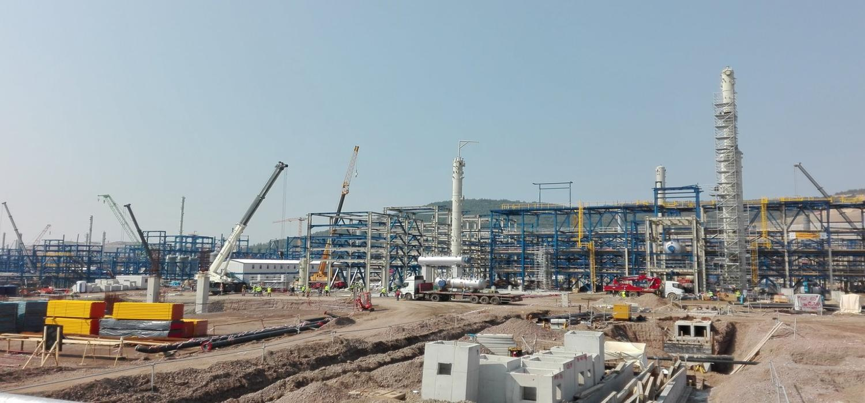
MECHANICAL ERECTION
Liquid & Pneumatic piping and accessories installation.
Pump, EOT crane installation.
Tank Fabrication.
Mechanical Structure installation.
Developed & Managed by INDITRON ELECTRONICS

Slide 26
ELECTRICAL INSTALLATION
Erection and testing of Transformer, HT/ LT switchgears, motors, lighting installation, fabrication and erection of cable trays , HT/ LT cable laying and termination etc. and all other kind of electrical installation.
Design & Detailing of Electrical system.
Developed & Managed by INDITRON ELECTRONICS

Slide 27
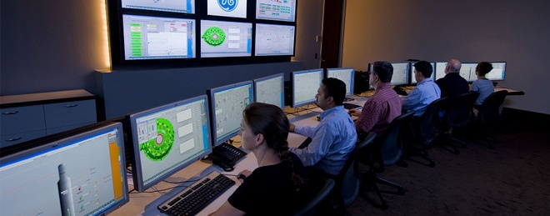
INSTRUMENTATION - INSTALLATION
Calibration, testing and erection of all kinds of transmitters, analyzers, controllers, annunciators, recorders, indicators, distributors etc.
Testing commissioning of Control panel and preparation of control scheme Inspection, Testing and commissioning of PLC.
We also undertake PLC/DCS FAT (Factory Acceptance Test) activity.
Erection and commissioning of Pneumatic actuators, converter and control valves and Pneumatic line and tubing.
Design and detailing of Instrumentation system.

Slide 28

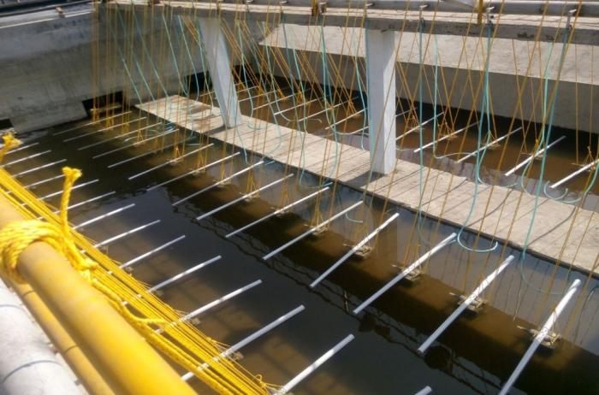
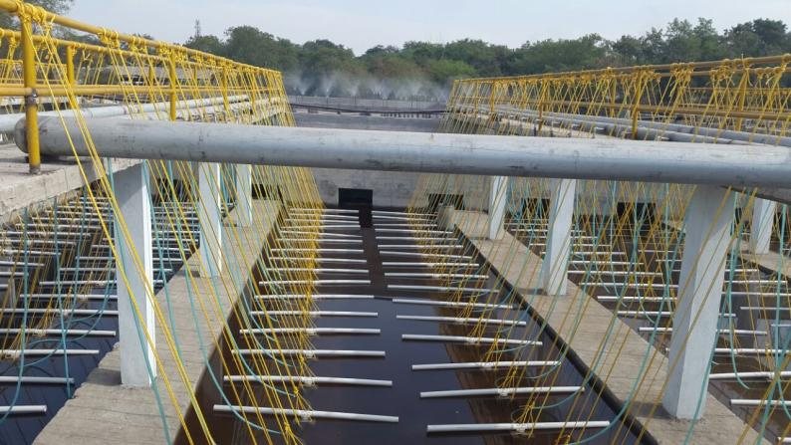
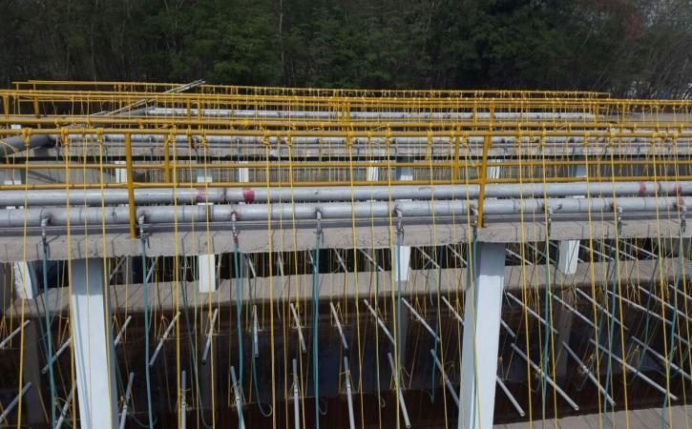
ETP AERATION TANK ERECTION
Quality means doing it right.... When no one is looking.
Developed & Managed by INDITRON ELECTRONICS

Slide 29
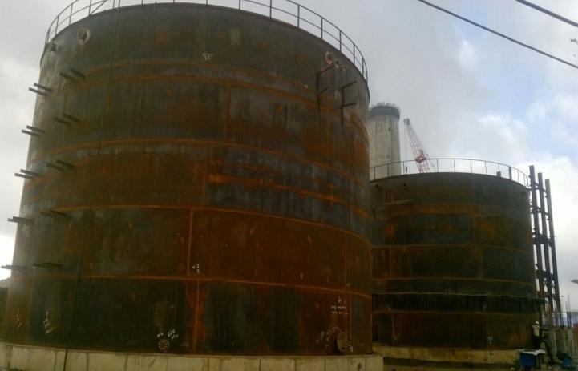
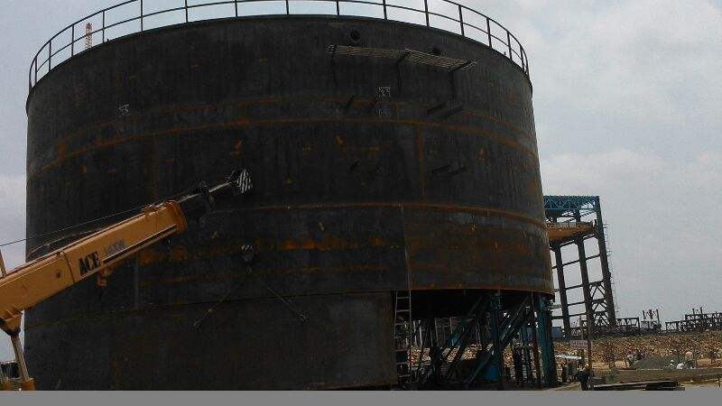
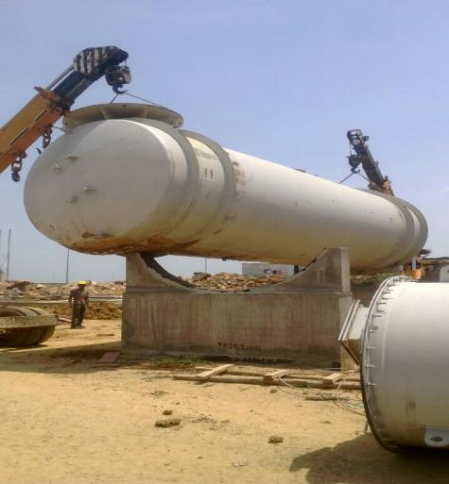
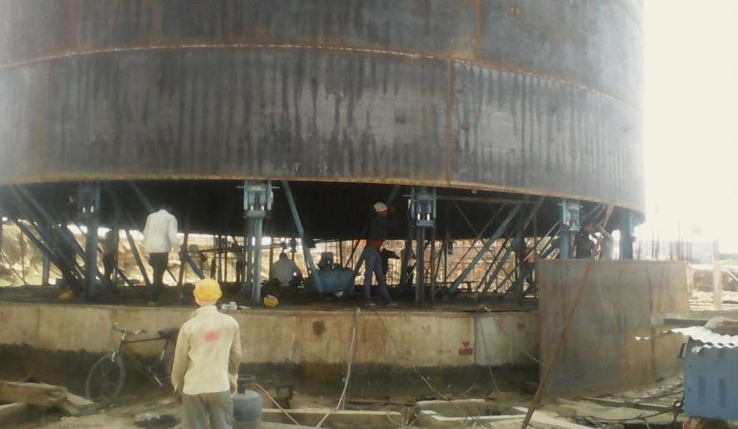
MECHANICAL TANK FABRICATION
Developed & Managed by INDITRON ELECTRONICS

Slide 30
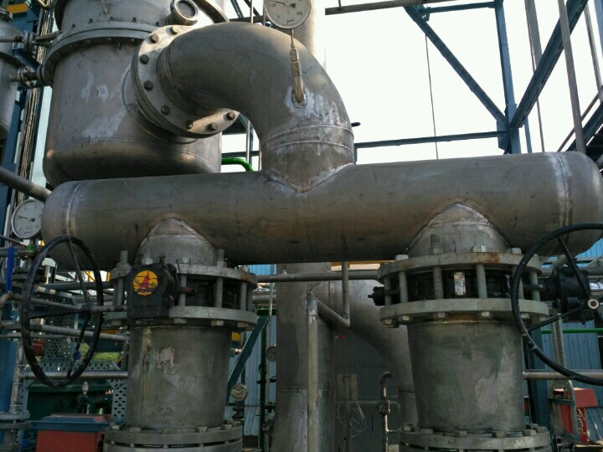
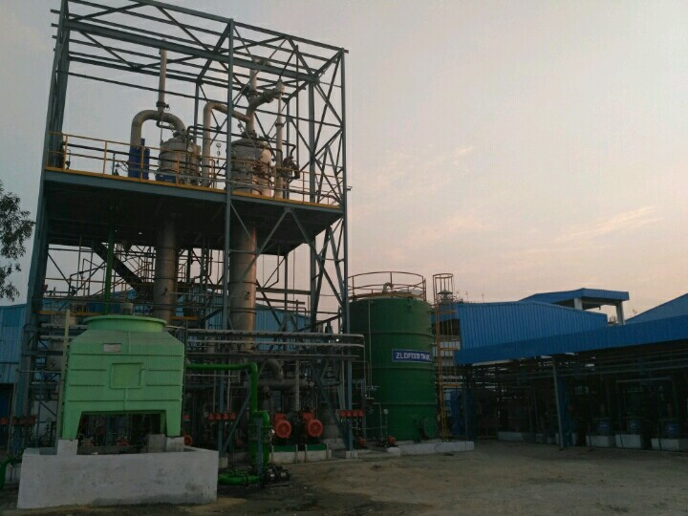
MECHANICAL STRUCTURE WORK
Developed & Managed by INDITRON ELECTRONICS

Slide 31
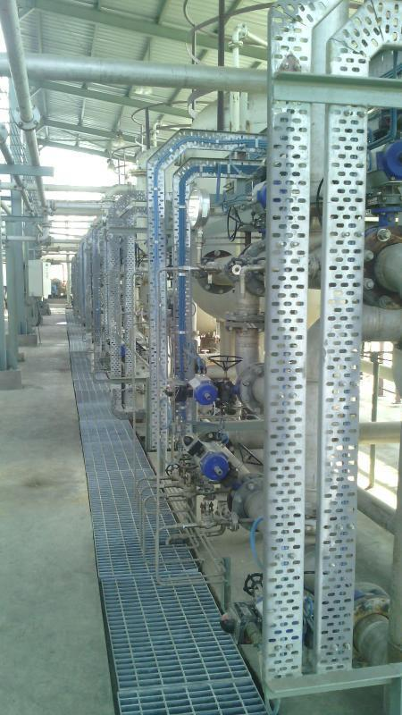
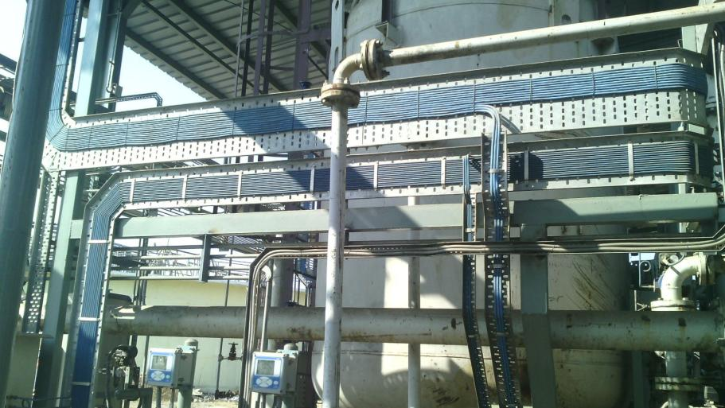
PHOTOGRAPH OF EXUCUTED PROJECT
ERECTION AT NTPC Allahadabad (Meja Urja Nigam)
Developed & Managed by INDITRON ELECTRONICS

Slide 32

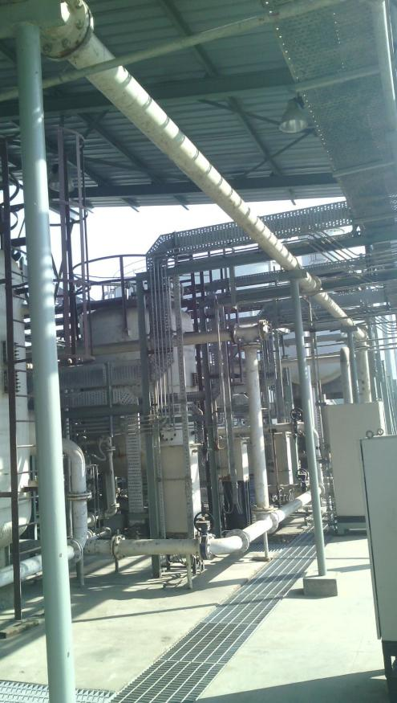

CABLE TRAY WITH CABLE LAYING
Developed & Managed by INDITRON ELECTRONICS

Slide 33
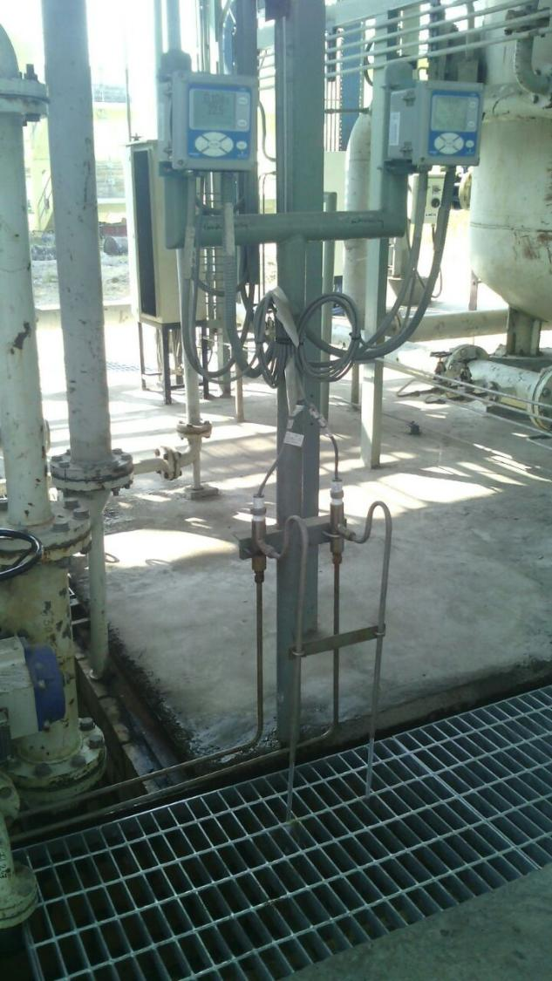
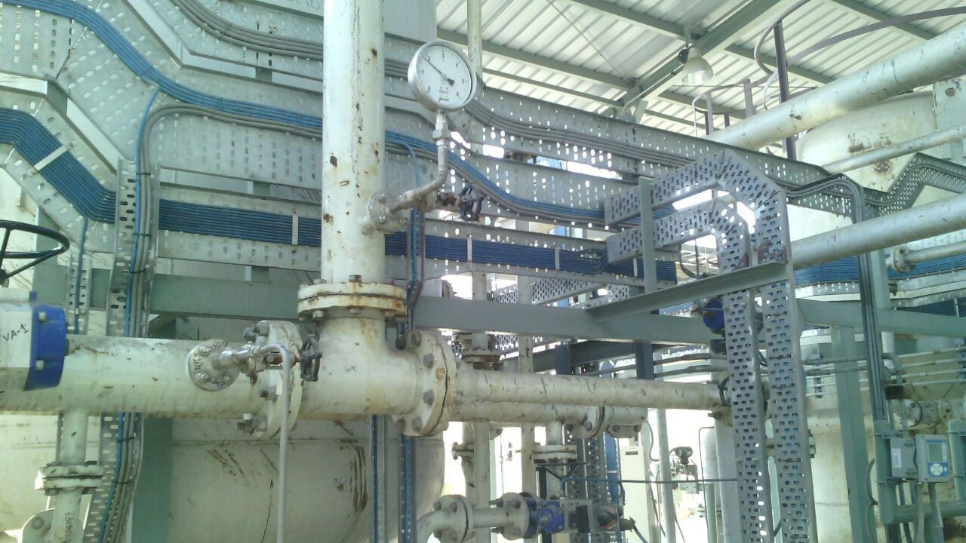
INSTRUMENTATION ERECTION WORK

Slide 34
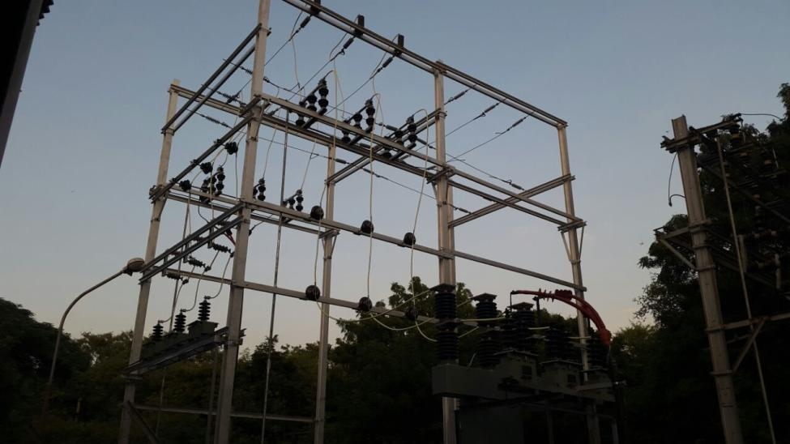
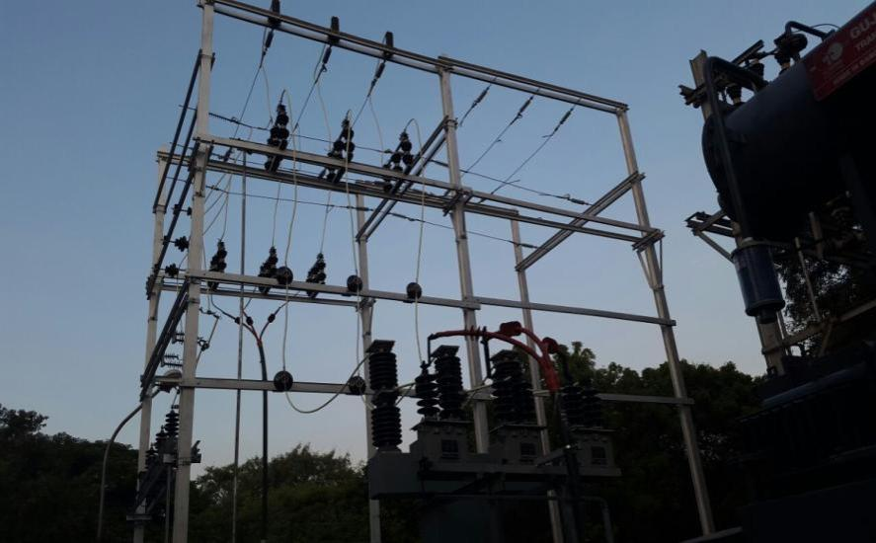
33 kV HT TRANSFORMER, VCB, CT, PT ERECTION WORK
PROJECT LOCATION:
NAVIN FLUORINE INTERNATIONAL LIMITED, DEWAS
Developed & Managed by INDITRON ELECTRONICS

Slide 35
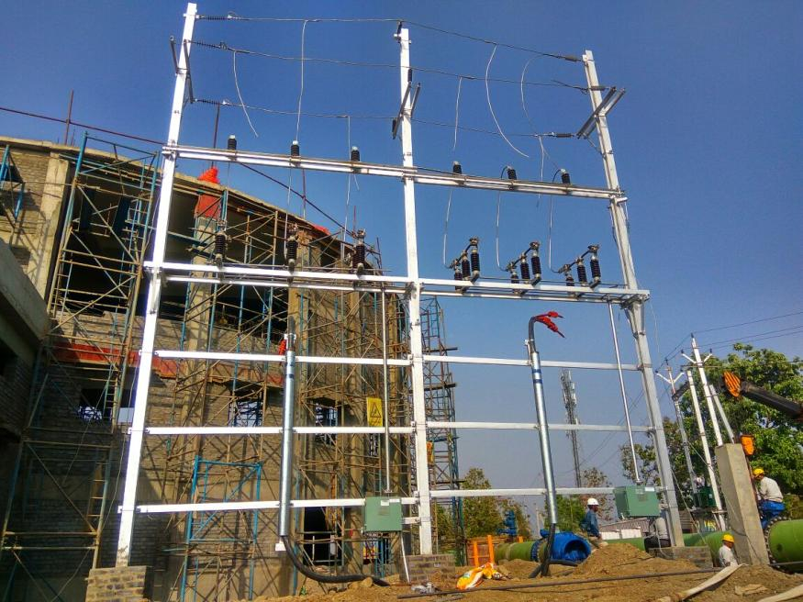
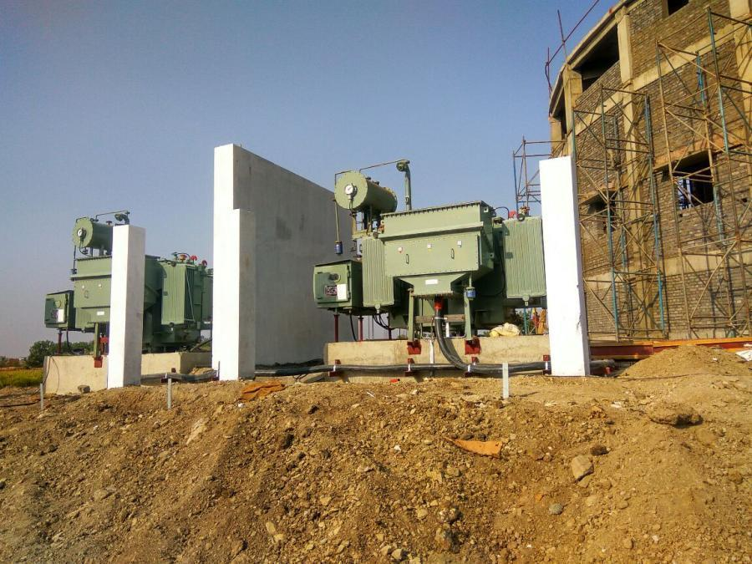
SUBSTATION
& TRANSFORMER WORK
PROJECT LOCATION:
WATER & EFFUELENT TREATMENT IC FOR SIMROL INDORE
Developed & Managed by INDITRON ELECTRONICS

Slide 36
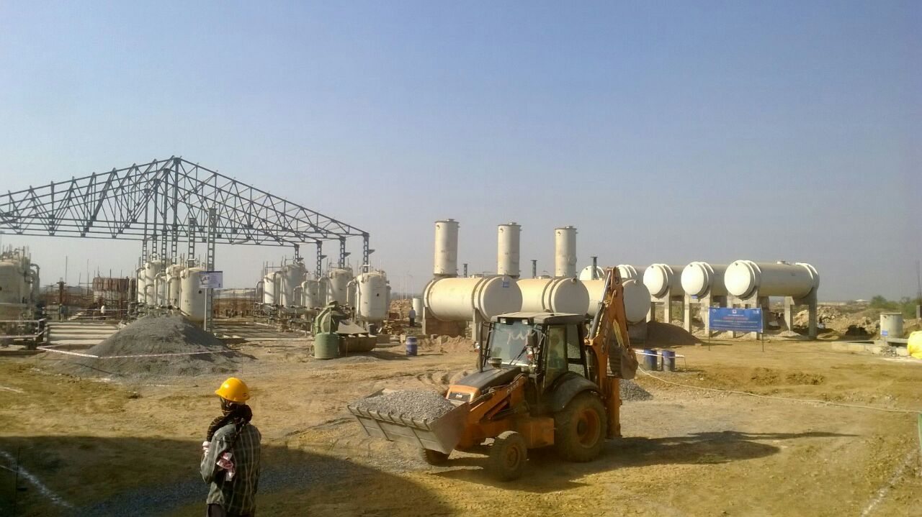
PLANT ERECTION
Developed & Managed by INDITRON ELECTRONICS

Slide 37


OPERATION & MAINTENANCE
Thorough process knowledge of
    Raw water pre-treatment.
    De - Mineralization systems.
    Reverse Osmosis plants.
    Effluent treatment plants.
    Sewage treatment plants.
    Cooling Towers.
    Pump House.
    Chemical dosing systems etc.

Slide 38

O&M WORK
Operation & Maintenance of 3000 M³ RWTP at BORL, BINA Refinery.
Operation of 3000M³ Cooling Tower at BORL, BINA refinery.
Operation of Fire water Pump house at BORL, BINA refinery.
Operation of 4 MW Emergency Diesel Generator Set at BORL, BINA refinery.
Operation of 2 MW Emergency Diesel Generator Set at BORL, BINA refinery.
Operation & Maintenance of DM Plant at BPCL Mumbai.
Operation & maintenance of DM Plant at Ranbaxy laboratories, Dewas-MP.
Developed & Managed by INDITRON ELECTRONICS

Slide 39


O & M work of Raw water treatment Plant BORL, Bina
Developed & Managed by INDITRON ELECTRONICS

Slide 40


MV & LV SYSTEM DESIGN.
TRANSFORMER , HT SUBSTATION & DG SET LOAD CALCULATION.
LIGHTNING PROTECTION & EARTHING SYSTEM WORK.
CABLE & CABLE TRAY ROUTING.
ELECTRICITY BOARD & ELECTRICAL INSPECTOR: DRAWING SUBMISSION, APPROVAL OF DRAWINGS & LIASIONING
FIRE ALARM & ACESS CONTROL SYSTEM DESIGN
DATA & VOICE SYSTEM DESIGN

Slide 41

DETAIL DESIGN & ENGINEERING
Project Electrical System Requirements.
Specifications for electrical equipments.
Data sheets for electrical equipments.
Equipment/load list.
List of deliverables.
Fault Level Calculation.
Relay Co-Ordination schedule.
Transformer sizing.
Generator sizing.
Substaion layout.
Cable sizing & voltage drop.
Cable gland schedule.
Lux level calculations.
Earthing calculation.
Power Factor Correction.
Key Single Line Diagram.
Plant Lighting Layout.
Cable routing layout.
Typical Installation Drawings.
Typical Control Schematic Drawings.
Typical Control Schematic Drawing for Protection & Metering Circuits.
Typical Control Schematic Drawing for Motor & Power feeders.
Typical Installation Drawings.
Bill of Materials & Selection of vendor & sub vendor.

Slide 42

COMPANY GROWTH
Developed & Managed by INDITRON ELECTRONICS

Slide 43

PEOPLE AT INDITRON
ENGINEER
  Mr. CHANDRAMOHAN SHRIVASTAVA
  Mr. RK MITRA
  Mrs. DHANSHRI KAVITKAR
  Mr. SOUMYA DIP PAUL
  Mr. BHUPENDRA PATEL
  Ms. MONICA BANERJEE
  Mr. MAYANK SHARMA
QUALITY CONTROL
  Mr. ADTIYA GUPTA
  Mr. NIDHIR SARKAR
SUPERVISOR
  ELECTRICAL
    SHERSINGH RATHORE
    RAJENDRA PRAJAPTI
    RAJESH SISODIYA
    AJIT CHANDRA SARKAR
  INSTRUMENTATION
    SUKUMAR GAIN
    OM PRAKASH PRAJAPATI
  MECHANICAL
    ISWARLAL SISODIYA
    GOLU KHAN
    SHIVALAL DAIMA
  OPERATION & MAINTENANCE
    SANDEEP YADAV
    PN KHARE
SHAFETY OFFICER
  Mr. SANJEET SARKAR
  ACCOUNTANT (4 NOS.)
  ELECTRICIAN (10 NOS.)
  FITTER (15 NOS.)
  INSTRUMENT TECHNICIAN (5 NOS)
  HELPER (20 NOS.)
  OPERATION & MAINTENANCE STAFF (20 NOS)
Developed & Managed by INDITRON ELECTRONICS

Slide 44

RECENT KEY ACHIVEMENTS
1. Constructions of 12 MLD Water Treatment Plant at Shahganj, Dist Budni (Jindal infra ltd )
2. Constructions of 30 MLD water Treatment Plant at Singrouli (M.P) behalf of Thermax Ltd - Hindlaco, Mahan aluminum projects
3. Design Drawing & Constructions of 45 MLD Sewage Treatment Plant- Gharpore engineering by Bhavnagar Municipal Corporation
4. Operation and maintenance of 90 MLD WTP for BORL – Bina MP
5. Design Drawing & Constructions of 12.00 MLD Water Treatment Plant, CFCL Kota by Thermax.
6. Electrical Design Drawing & Construction of API Plant, THINQ PHARMA CR0 LIMITED.
The above project are covered with Installation, testing and commissioning of the plants.
"We have been officially invited by Project Implementation Unit, PWD Bhopal to give Seminar on STP and ETP under INDIAN BUILDING CONGRESS , Chapter Bhopal"

Slide 45
LIST OF PLANT MACHINERY
SR NO. | DESCRIPTION | CAPACITY | QUANTITY
1. | 3 AXIS CNC Synchro Hydraulic Press Brake |  | 1 NOS.
2. | HYDRAULIC SHERING MACHINE |  | 1 NOS.
3. | HYDRAULIC PRESS MACHINE |  | 1 NOS.
4. | SPRAY BOOTH FOR POWEDER COATING |  | 1 NOS.
5. | OVEN |  | 1 NOS.
6. | COMPRESSOR |  | 1 NOS.
7. | WIRE ROPE HOIST |  | 1 NOS.
8. | STAND DRILL MACHINE |  | 2 NOS.
9. | HAND DRILL MACHINE |  | 10 NOS.
10. | GRANDING MACHINE |  | 5 NOS.
11. | WELDING MACHINE |  | 10 NOS
12. | TUBE BENDER |  | 5 NOS.
13. | SHEET BENDING MACHINE |  | 1 NOS
14. | HYDRAULIK JACK |  | 1 SET
15. | CRIMPING TOOL SET |  | 20 NOS
16. | FERRULE PRINTING MACHINE |  | 3 NOS
17. | TOOL KIT |  | 5 SET
18.
Developed & Managed by INDITRON ELECTRONICS

Slide 46
LIST OF QUALITY CONTROL MACHINERY
SR NO.C | DESCRIPTION | CAPACITY | QUANTITY
1. | MULTIMETER |  | 2 NOS.
2. | Insulation Tester (500 V, 1000 V, 2500 V) |  | 2 NOS.
3. | Earth Tester |  | 3 NOS.
4. | Primary Injection Kit |  | 1 NOS.
5. | 4 to 20 ma. Source and sink |  | 1 NOS.
6. | Master gauges |  | 2 NOS.
7. | pH simulator |  | 1 NOS.
8. | Conductivity simulator |  | 1 NOS.
9. | Digital temp. Indicator |  | 1 NOS.
10. | 2.5 kV HV TEST KIT |  | 1 NOS.
11. | DFT METER |  | 1 NOS.
12. | RAL COLOR CHART |  | 1 NOS.
13. | TDS METER |  | 1 NOS.
Developed & Managed by INDITRON ELECTRONICS

Slide 47

Q
Quality Policy
INDITRON dedicates itself to total quality
It will constantly strive to exult the customers By anticipating and exceeding their expectations continuous improvement, Teamwork, Commitment Integrity and Excellence shall be the guiding values.
Date – 01st , April 2018
(Mr. C.M. Shrivastava)
MANAGING DIRECTOR
Developed & Managed by INDITRON ELECTRONICS

Slide 48

Developed & Managed by INDITRON ELECTRONICS

Slide 49

SHAFETY TRAINING

Slide 50

EMPLOYEE WELFARE PROGRAMME
© INDITRON ELECTRONICS, All rights reserved
Developed & Managed by INDITRON ELECTRONICS

Slide 51



Lets go hand in hand…
Not one Before Another..

Slide 52

Customer Relationships
Customer service is not a department, It’s everyone’s Job.
Many of the leading OEMs from almost every industry are among Chitransh Electricals’s clientele. It is not only Chitransh Electricals’s expertise that they opt for, but also for the core values of the company: flexibility, speed, innovation, transparency and reliability and above all safety measures. These are key values, especially in the complex high tech world where Chitransh Electricals both closely monitors trends and is an innovator of new developments. These five core values coupled to the qualities of our employees are the foundation on which we build relationships with our customers.
© INDITRON ELECTRONICS, All rights reserved
Developed & Managed by INDITRON ELECTRONICS

Slide 53
















SOME OF OUR PRESTIGIOUS CLIENTELE
Scores of satisfied clients from all over the INDIA stand testimony to the excellence of INDITRON. Some of the prestigious clients of INDITRON are:
“Customer is the most important visitor on our premises.
He is not dependent on us, We are dependent on him.
He is not an interruption on our work;
He is the purpose of it.
He is not an outsider to our business;
He is a part of it.
We are not doing him a favour by serving him; He is doing us a favour by giving us an opportunity to do so.”
MAHATMA GANDHI

Slide 54















SOME OF OUR PRESTIGIOUS CLIENTELE

Slide 55














CLIENTELE – END USER

Slide 56

CONTACT US:
We all at INDITRON aspire to untiringly reinforce this distilled wisdom through continuously anticipating, meeting and exceeding your expectations from us. Thank you for your trust and patronage. It supports us deliver Global, Safe and Reliable Power Distribution Solutions for your customized needs.
Contact person:
Mr. C.M. Shrivastava (Managing Director) - ( = +91 - 9993576730)
Mr. Yogesh Chawrekar (Sales Manager) - ( = +91 - 9009770171)
Office & factory:
40-41/3, Industrial Area No. -1,
A.B. Road, Dewas, Madhya Pradesh – 455 001.
Phone No. = +91 – 727 – 2259525
+91 – 727 - 2259526
Website = http://www.inditron.in/
E- Mail = works@inditron.in
Developed & Managed by INDITRON ELECTRONICS

Slide 57


